Slide 1
Pushpak Air-shipping Company
Team Valorant

Slide 2
Case Understanding
Since rise of e-commerce, hyper-local delivery models have seen steep adoption among businesses and added to customer's ease.
The next big thing in hyper-local delivery is use of drones, which is largely in experimental phase.
According to the Print, the Indian drone market size is set to grow steeply from $1.21 billion in 2021 onwards.
Hence, this is a ripe time for Pushpak to make presence as a drone enabled courier company in the market
The objective is to achieve 3 things:
To achieve break even within 1 year
To establish brand in the market
To become market leader

Slide 3
B2C Model
Market expansion
B2B Model
BRAND JOURNEY
To become market leader, along with B2B model, company will start with B2C business as well
Pushpak will try to capture more cities and expand its customers
Focus on B2B model especially in 1st year to achieve break even faster

Slide 4
HR Department
HR Responsibilities
Human resources and legal departments must be aware of, and continuously monitor, applicable FAA and other state or municipal rules and regulations regulating commercial drone usage and deployment.
The HR department should determine if it is more cost effective to hire people with these skills as in-house workers or as part of an expanded or contractual workforce.
In the event of a shortfall or growth plans, the company may also hire freelancers to meet its drone piloting demands.
Training
Human resources will want to keep track of relevant certifications and may wish to provide training to staff who operate drones.
The qualified drone operators present in the organization might give further training to the freelancers for them to become acquainted with the piloting.
The HR department may also enroll pilots in drone piloting certification courses.
Accidents may happen, and much like any other liability problem, HR must have a backup plan in place in case things go wrong.
A recurring issue is the requirement for quick, precise replies to regulatory compliance issues. Keeping an aviation attorney on retainer is a good idea. HR should recruit someone who can assist with accident reporting.

Slide 5
HR Department
Recruitment Plan and Cost
Senior Data engineer. Drone maintenance technician. Test operations engineer. Business Development team. Legal department
Number of employees to be hired is 11. In India, the per hiring cost factor has been estimated to be about Rs. 25,500 for almost all industries.. The training cost in India averages to Rs 16,350 Total cost of hiring will be 25500 x 11 = Rs 280,500.
Total cost of training will be 16350 x 11 = Rs 179,800

Slide 6
Marketing
Our target market includes participants like Food Delivery Companies, Pharma Companies, and Local Deliveries for retail chains
Apart from this, we can collaborate with Hospitals, Banks, and Governments to deliver important packages rapidly between locations.
During the initial years, our focus would be B2B businesses wherein we would try to collaborate with as many businesses as possible and later shift our focus towards individual customers and delivering their packages.
The following approaches will be used to promote our company:
SEO
Cold Calls
Social media
Banners and billboards
Influencer marketing
Advertising

Slide 7
IT department
Objectives:
Plan customer journey along the service
Develop website and app for B2C customer interaction
Develop web portal for B2B customer interaction
Arrange cloud infrastructure for web hosting and data storage
Identify use cases for drone management system and train operation team
Secure IT operations and ensure business continuity
Establish disaster recovery policy in case of security breach and avoid data loss
Modules under in drone management system
Client books service
Drone picks-up good from client
Drone routed to recipient
Weight of good verified by system
Drop confirmed by recipient
Drone returns to center
Recipient acknowledges availability at drop location
Planned customer journey
- event log generated and communicated with customer along with live tracking

Slide 8
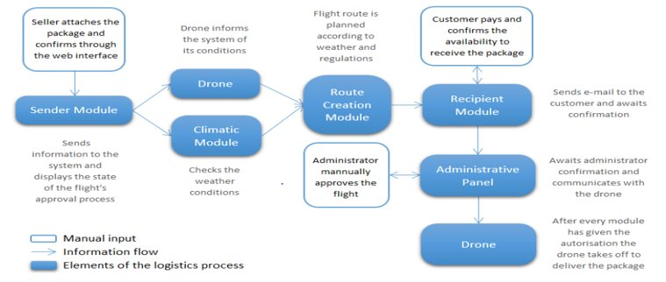
IT department
Procedure in drone management system once booking is placed

Slide 9
IT department
Customer interaction:
Understand distinction between B2C and B2B client requirements
The common features required are:
- customer must be able to select the weight category
- input drop off location via address or on map
- schedule pickup
- sender module to confirm attachment of good to drone
- live tracking of courier
As planned for year 1, the business will be tested with B2B clients.
Portal for B2B customers: B2B clients require low latency, high performance web portal to book service. Payments shall occur in bulk at end of subscription period or on daily basis. Since business does not require huge working capital, deferred payments can be allowed.
From year 2, B2C channel shall be enabled.
Website/ app for B2C customers: B2C customers require ease of usage. Hence, mobility through use of app as well as smooth user interface on both app and website is favored. The interface shall contain pickup option in addition payment module.

Slide 10
IT department
Drone management system
Responsible for end-to-end drone operation management
Contains modules to confirm sender’s attachment, climate monitoring, route creation, receiver’s confirmation and finally administrative control for contingency conditions
Cyber security
Drone security – Selection of hack resistant and compatible OS for drone like seL4.
Website security – Following practices such as installing SSL certificate, using firewall, reducing XSS vulnerabilities, minimizing third party api exposures can prevent website hacking.
Data security – Access control and strong encryption to follow along with security features enabled by cloud hosting
Making IT policies & training procedure
Preparation of protocols to ensure the sensitive data such as passwords or user info is not leaked by employees
Ensure training is provided to employees to use systems to avoid phishing and leaving systems vulnerable
Cloud disaster recovery and data backup
Creating redundancy to manage situation of website crash or hacking by switching to alternate host server on cloud platform
Creating regular data backup to maintain data consistency, detect any changes in record and prevent data loss

Slide 11
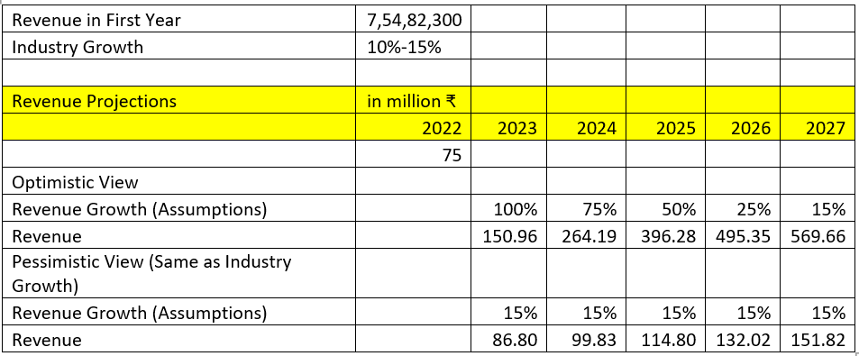
Finance Department
Budget assigned is ₹10 crores
Initial Investment made by the company is Fixed Cost = ₹3,400,000 & Variable Cost = ₹11,400,000
After adding the expenditures of various departments and capital expenditure of buying more drones the total cost comes to ₹75,482,300
For Break Even in First Year, the company needs to have a revenue equal to more than the above total cost which is ₹75,482,300.
Since this is a start-up, we assume high growth in the initial years and later on assimilate in the industry.
Revenue projections assuming both optimistic and pessimistic view are shown in the table to the side.

